Slide 1
myEHR
Sprint 5

Slide 2
Team Malak
Josh Halat
Jordan Shostak
Kaitlin Wheeler

Slide 3
Sprint Goals
Implement more admin functionality
Create patient search feature
Update alerts bar function
Update single visit view

Slide 4
Sprint Accomplishments
Created:
Admin ability to create, update, and delete data
Patient search feature
Automatic BMI calculation on vital record entry
Updated:
Patient alerts feature
Single visit view
Various formatting elements per client request

Slide 5
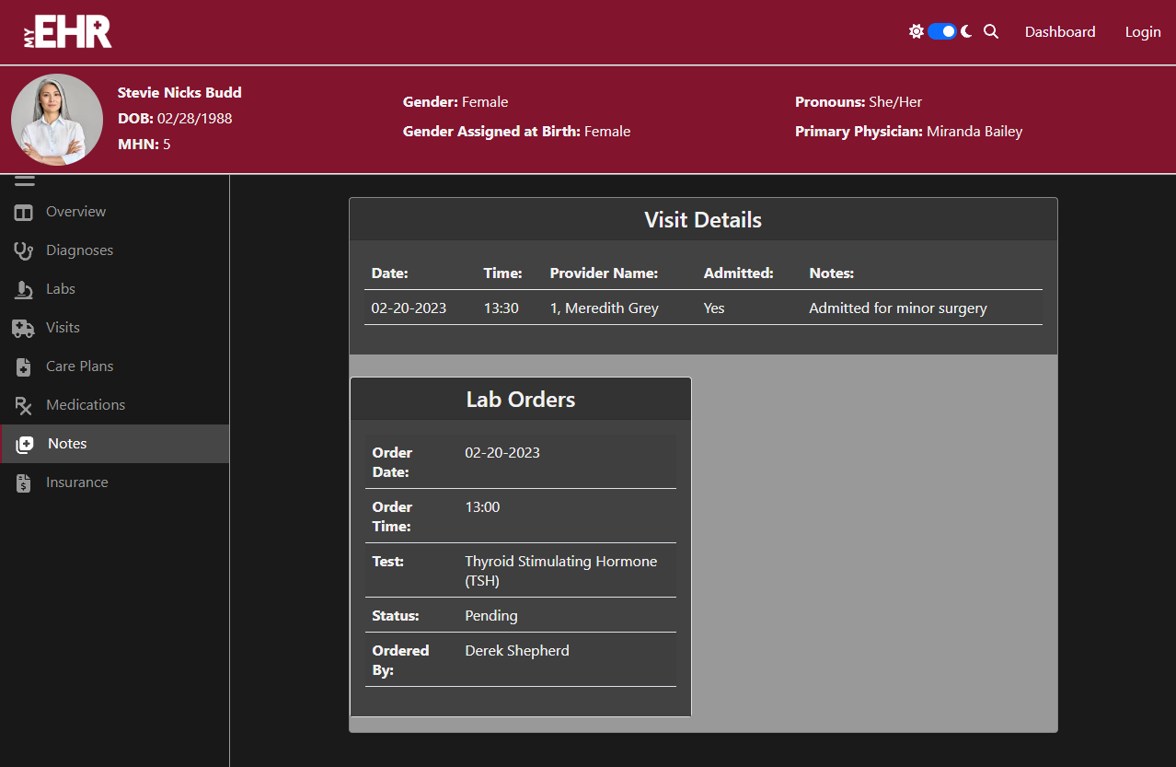
Live Demo

Slide 6
Review
Increased functionality
Admin can now create, edit, and delete data
Added patient search feature
Broadened scope of information
More patient record views
Updated patient alerts and visits
Added BMI calculation
Enhanced visual appeal
Updated site formatting to fit client’s requests

Slide 7
Questions?

